Slide 1
Lab 2 Final Presentation
Brendan Mattina, Ziwei Zhao, Jonathan Moges

Slide 2
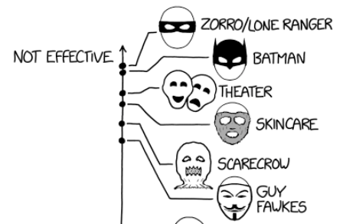
Research Questions
How are state-imposed mask mandates associated with current COVID death rates in each state?
How closely is COVID public opinion in each state associated with its current COVID death rate?
How closely is the imposition of ‘secondary’ state-wide COVID mitigation strategies and mobility data associated with COVID death rates in each state?

Slide 3
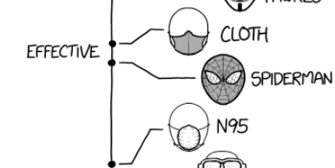
Data/Variables
Provided COVID Related Data Sets
Death rate per million
Length of face mask mandate
Length of stay at home order
Google mobility data - home
Length before Reopening:
Childcare
Restaurants
Bars
“Would I bet a semester of tuition on this data being true.”
- Dr. Douglas Alex Hughes PhD
ANES data (from lab 1), updated for 2020
"How worried are you personally about getting the Coronavirus?"
Notes:
Mobility data aggregated as a mean
ANES data chosen because of reliability (reliably gathered and representative of opinions of the US population), simplicity and our familiarity with the data set
Question a good proxy for our research question - assuming that opinions of fear about getting COVID is aligned with compliance with state-imposed mask mandates

Slide 4
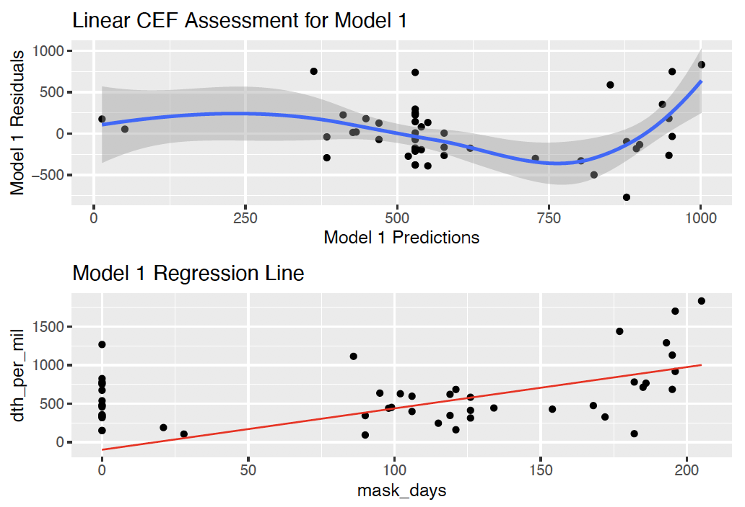
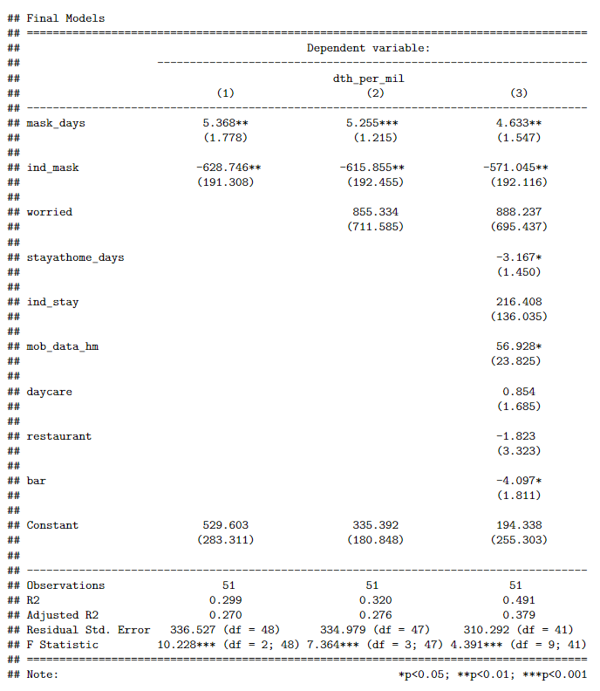
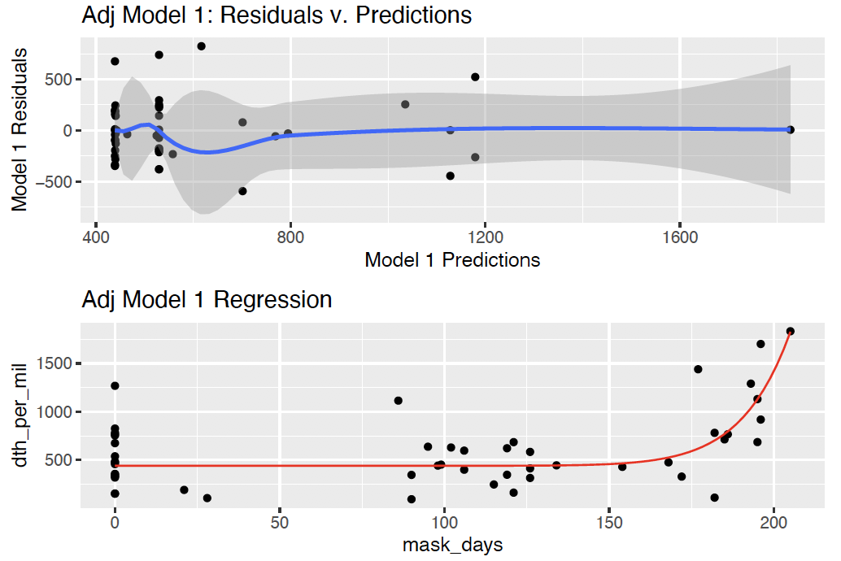
Results and CLM
Notes:
Model 1 - Brendan
Model 2 - Jonathan
Model 3 - Ziwei

Slide 5
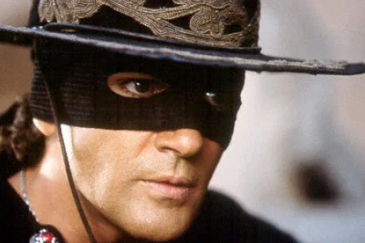

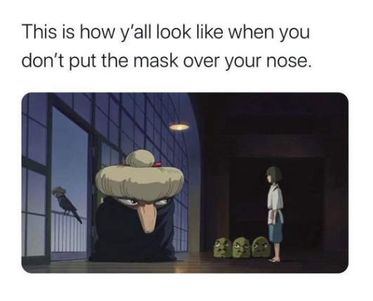
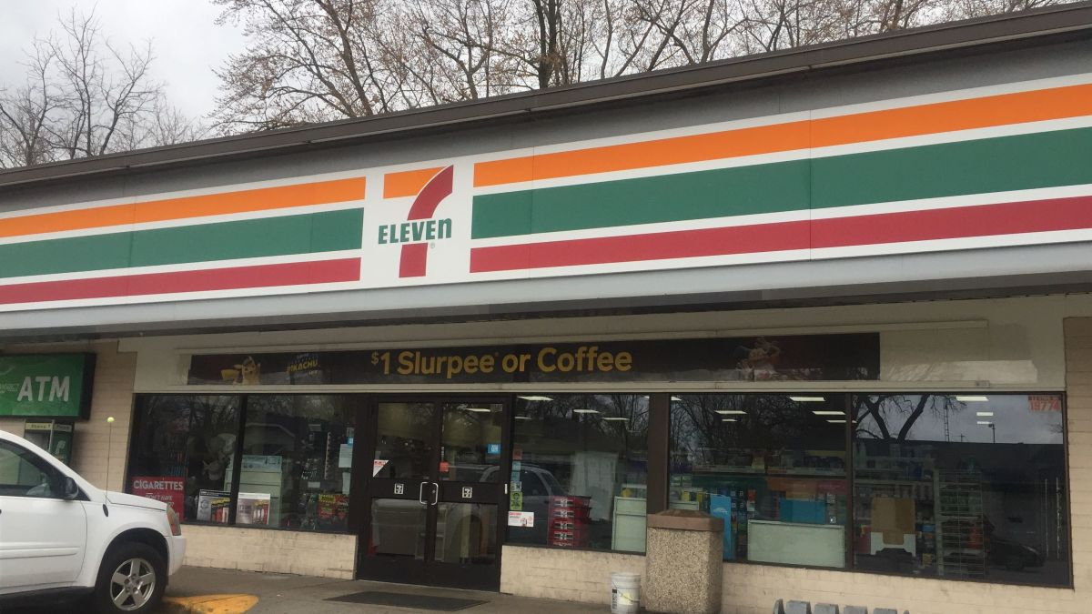
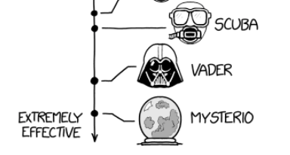
Omitted Variables and Conclusions
Compliance
Business
Personal
Changes in Opinion
Notes:
Three omitted variables - compliance both personal and by businesses. Compliance refers to how people comply with mask mandates and how well businesses comply with stay-at-home orders. As we’ve seen - ad lib, there’ve been significant divides between states, citizens and business owners.
These omitted variables matter because even though states established mask orders or business closures, they are meaningless without compliance. Even though our model was descriptive and not explanatory, we felt it necessary to have a discussion about omitted variables.
Our purpose in introducing these omitted variables to acknowledge the humanity of our data. It’s to say that policy does not always align with businesses or citizens. Our observations could have been affected by choices made by businesses to remain perpetually open and for people to wear ineffective masks, like Zorro or Batman or to show their noses, like Yubaba in defiance of the state mandates . All jokes aside, the seriousness of the omitted variables around compliance is very real and has implications for our models.
Another important omitted variable is referred to as changes in opinion, we included external data - updated ANES from lab 1, to help gain a better understanding of the concern people felt about catching the coronavirus. However, this survey took place in early April while our data was aggregated in late October. Within those six months, states have imposed and relaxed mandates and hundreds of thousands of people died. We would anticipate the opinions measured in April to shift, to some degree, in October and it is important to capture this omitted variable.
While our focus is not on a causal model, so drawing relationships between mask mandates and deaths is not our objective, we see evidence that supports our research question - How are state-imposed mask mandates associated with total COVID deaths (per million people) in
each state? and opportunity for further discussion and analysis around some of the omitted variables and opportunity to build on what has been developed and create an explanatory model.The associations described in the analysis exist. We observed statistically significant associations between mask mandates, mobility data of changes in time spent at home, length of stay at home orders and closures of bars. While not every variable we included was deemed statistically significant, we observed associations that would open doors to additional research questions that may be descriptive or explanatory in nature. One could wonder what affect these state ordered mandates had on the number of deaths, or measuring the effect of changes in home mobility on death.
On a personal note, this has been an amazing experience and an incredible team. I would like to thank brendan and ZEE-WEE as well as you all and ask if there are any questions

Slide 6
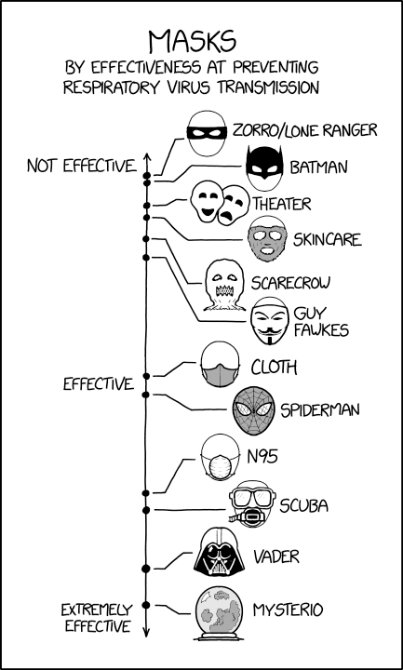
Thank You!
(Questions?)

